Slide 1
The adaptive Euler-Heun method

Slide 2
Introduction
In this topic, we will
Derive the adaptive Euler-Heun technique
Look at the implementation
See two examples

Slide 3
Adaptive Euler-Heun
Given (t_{k}, y_{k}), we will approximate
Our two approximations are:
Our approximation of the error of Euler’s method is:

Slide 4
Adaptive Euler-Heun
From our analysis, Euler’s method is O(h²)
Solving this for C yields:
We want to choose the ideal ah so that the error is ε_{abs}(ah)
Solving this for a yields
Substituting in the approximation of C from above:

Slide 5
Adaptive Euler-Heun
Issue:
If we are always aiming for the ideal step size, the next ideal step size may be slightly larger or smaller
If we use too large a step size, we will be forced to recalculate
Therefore, we will actually use 0.9ah

Slide 6
Implementation
The implementation is straight-forward:
do {
double s0{ qdy.back() };
double y{ qy.back() + h*s0 };
double s1{ f( qt.back() + h, y ) };
double z{ qy.back() + h*(s0 + s1)/2.0 };
double a{ eps_abs*h/(2.0*std::abs( z - y )) };
if ( (a > 1.0) || (h == h_rng.first) ) {
qt.push( qt.back() + h );
qy.push( z );
qdy.push( f( qt.back(), z ) );
found = true;
}
a *= 0.9;

Slide 7
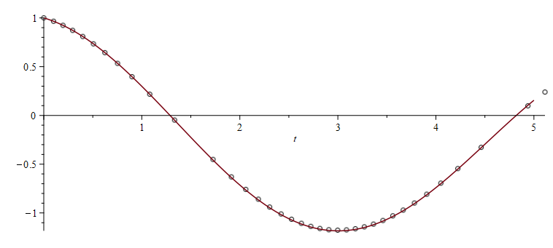
Example
Suppose we have
With h_{min} = 0.01 , h_{max} = 1 and ε_{abs} = 0.1, we have

Slide 8
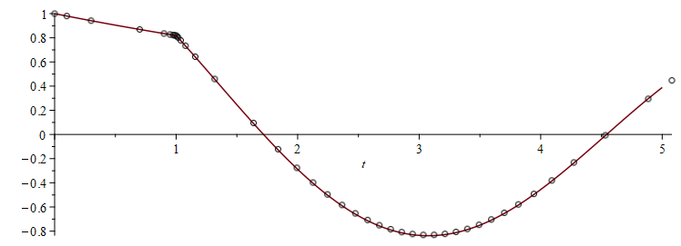
Example
Suppose we have
With h_{min} = 0.01 , h_{max} = 1 and ε_{abs} = 0.1, we have

Slide 9
Summary
Following this topic, you now
Understand the adaptive Euler-Heun method
Are aware of the derivation
Have seen the implementation
Have seen two examples

Slide 10
References
[1] https://en.wikipedia.org/wiki/Euler_method
[2] https://en.wikipedia.org/wiki/Heun%27s_method
[3] https://en.wikipedia.org/wiki/Adaptive_algorithm
[4] https://en.wikipedia.org/wiki/Adaptive_step_size

Slide 11
Acknowledgments
None so far.

Slide 12
Colophon
These slides were prepared using the Cambria typeface. Mathematical equations use Times New Roman, and source code is presented using Consolas. Mathematical equations are prepared in MathType by Design Science, Inc.
Examples may be formulated and checked using Maple by Maplesoft, Inc.
The photographs of flowers and a monarch butter appearing on the title slide and accenting the top of each other slide were taken at the Royal Botanical Gardens in October of 2017 by Douglas Wilhelm Harder. Please see
https://www.rbg.ca/
for more information.

Slide 13
Disclaimer
These slides are provided for the ece 204 Numerical methods course taught at the University of Waterloo. The material in it reflects the author’s best judgment in light of the information available to them at the time of preparation. Any reliance on these course slides by any party for any other purpose are the responsibility of such parties. The authors accept no responsibility for damages, if any, suffered by any party as a result of decisions made or actions based on these course slides for any other purpose than that for which it was intended.

